Slide 1
CDS 301
Spatial Autocorrelation
for Rent and Income in Virginia
Chaejun Lim & Ivan Einselen

Slide 2
Contents
Research Background & Objective
Data Gathering
Processing
Visualization
Conclusion

Slide 3

Research Background & Objective
1. Why this matters Income and rent are not randomly distributed. (We expect spatial clustering based on economic conditions.)
2. What we want to know Do high or low values form clusters? Where are income and rent spatially autocorrelated?
3. How we measure it - Use Global & Local Moran’s I - Measures spatial autocorrelation - Value closer to 1 = more clustering - Significance level: p < 0.05
- Expected Pattern - High-income clusters → Suburbs (Northern VA, Richmond) - Low-income clusters → Rural areas (Southwestern VA)

Slide 4
Data Gathering
Social Explorer :
American Community Survey (5-year Estimate)
U.S. Census Bureau TIGER/Line Shapefiles :
Census Tract(.shp)
Key Variables :
median house income & median gross rent
Year :
2011~2021

Slide 5
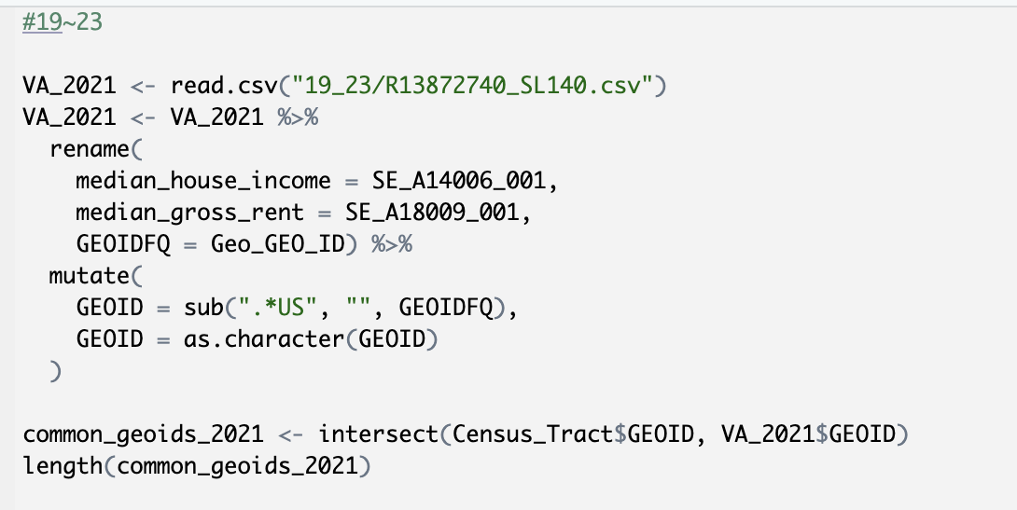
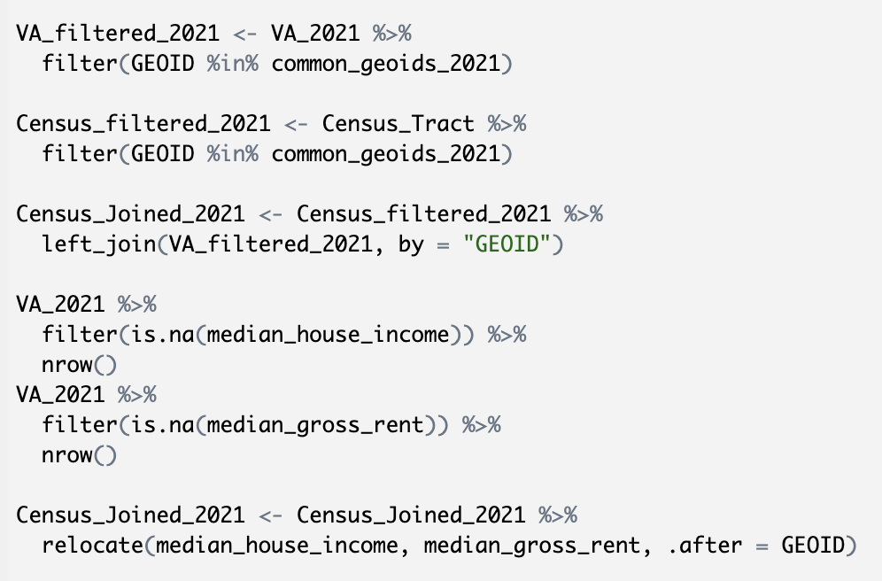
Data Processing - prep
Import & Clean data
Match and merge GEOID
Prepare for spatial analysis

Slide 6
Moran’s I and Spatial Autocorrelation
Global Moran’s I:
A value between -1 to 1 (think between 0 to 1 for this case)
The closer to 1, the more clustered an area is
Autocorrelation Map:
Shows the clusters
Red indicates higher values, blue indicates lower
Census Tracts are colored if significant
Everything is done at the significance level p < 0.05.

Slide 7
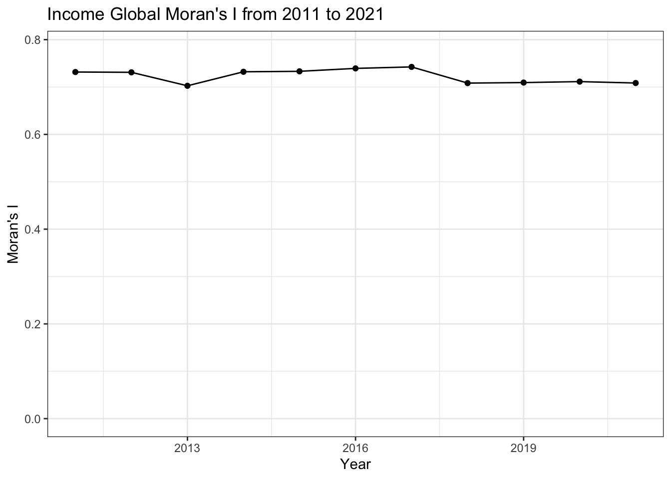
Moran’s I, Income
About 0.7 every year
Not much change
Indicates high autocorrelation

Slide 8
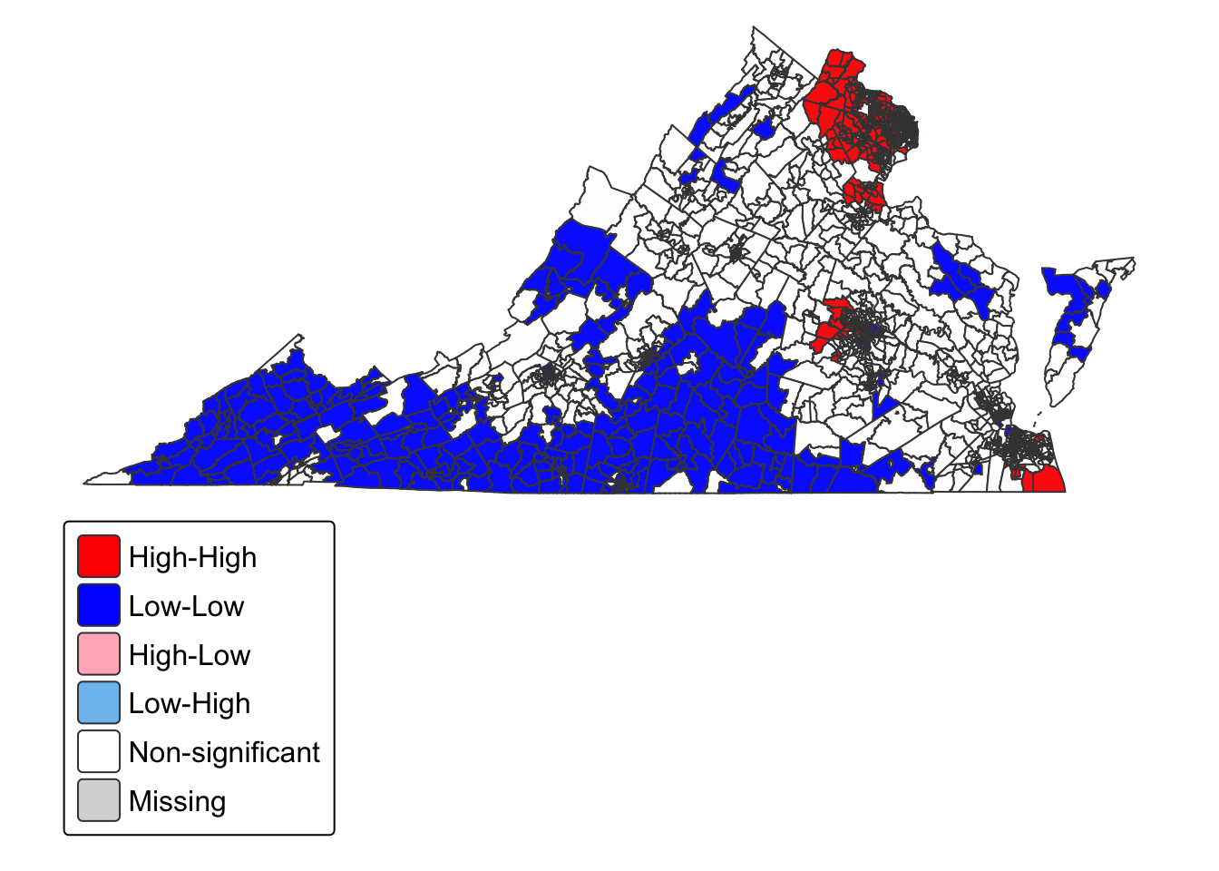
Income Map, 2021
Mostly red and blue
Red in suburban areas, especially NOVA, Richmond, and Hampton Roads
Blue in rural market areas (and within cities), especially Southwestern VA

Slide 9
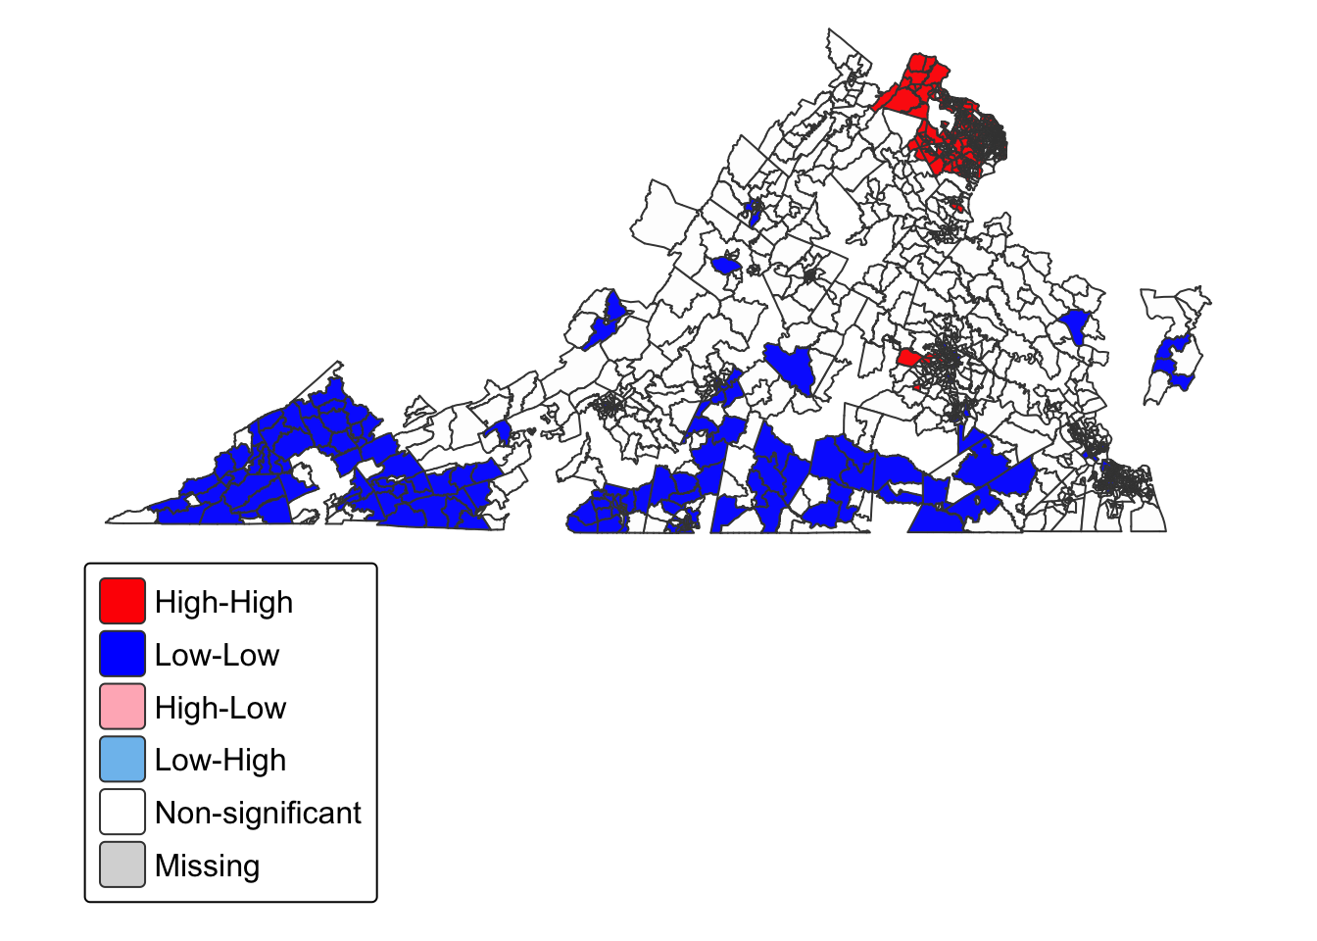
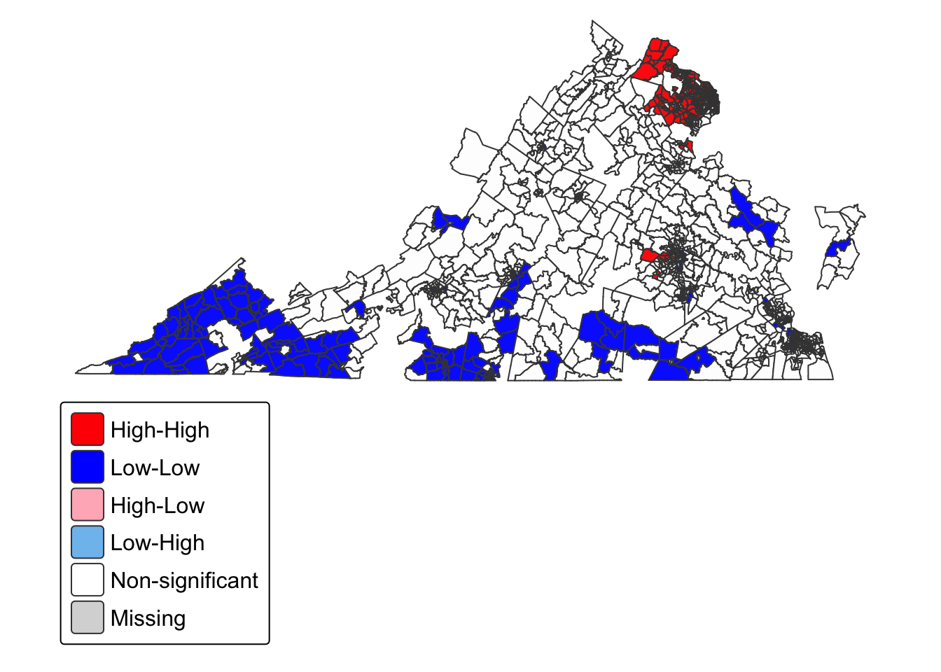
Income Map, 2011 & 2016
2011 on the left and 2016 on the right, similar trend but not as rich in data.

Slide 10
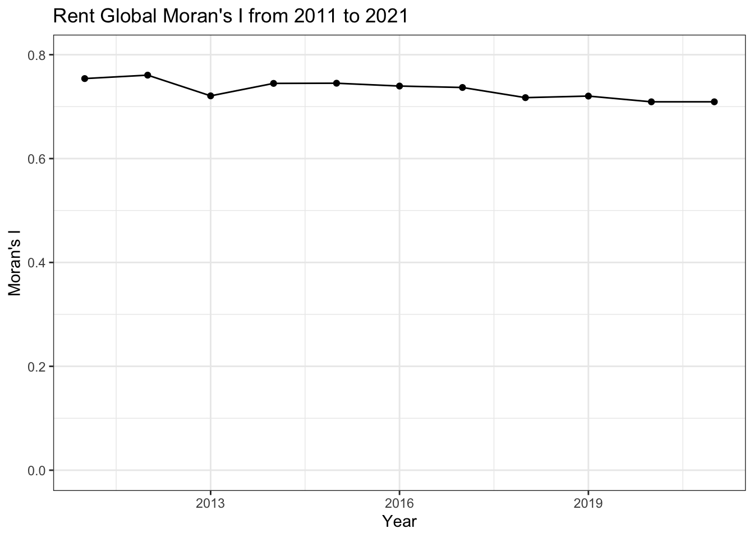
Moran’s I, Rent
Similar trend to income
Some error may arise from missing data

Slide 11
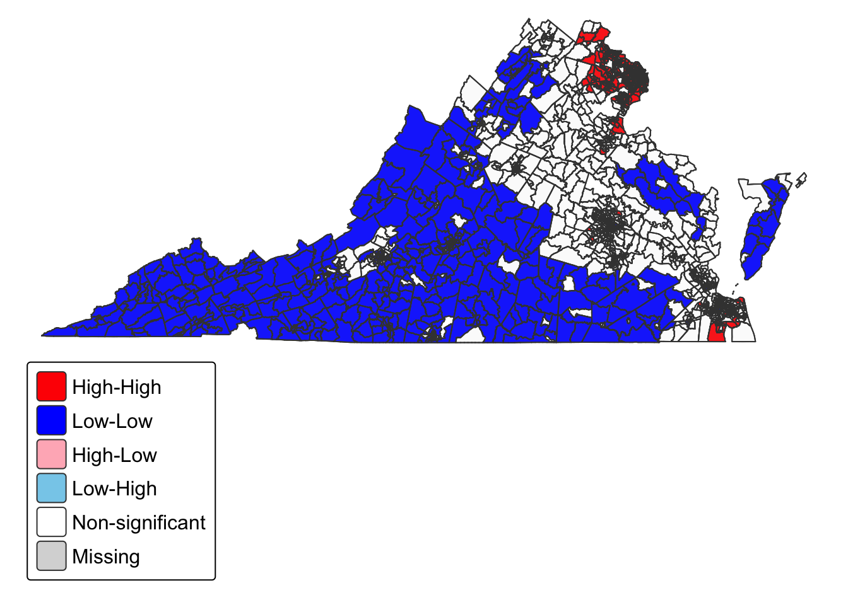
Rent Map, 2021
Roughly similar to income
More blue census tracts and less red
Red locations are huddled closer to cities

Slide 12
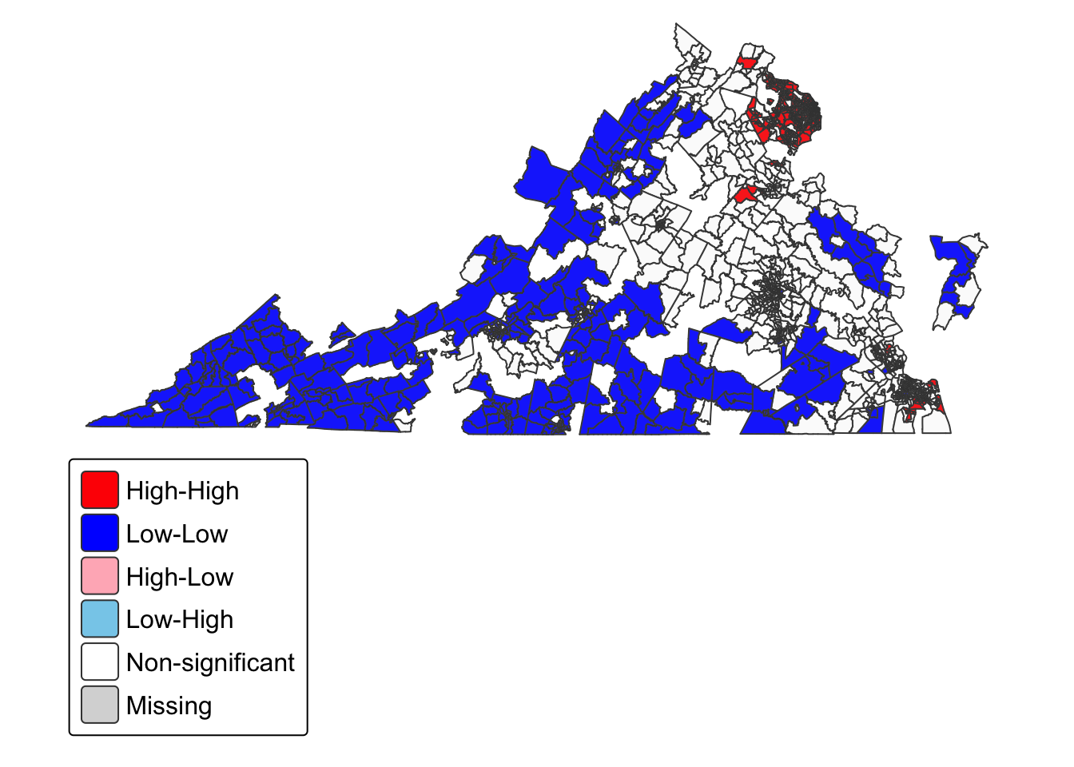
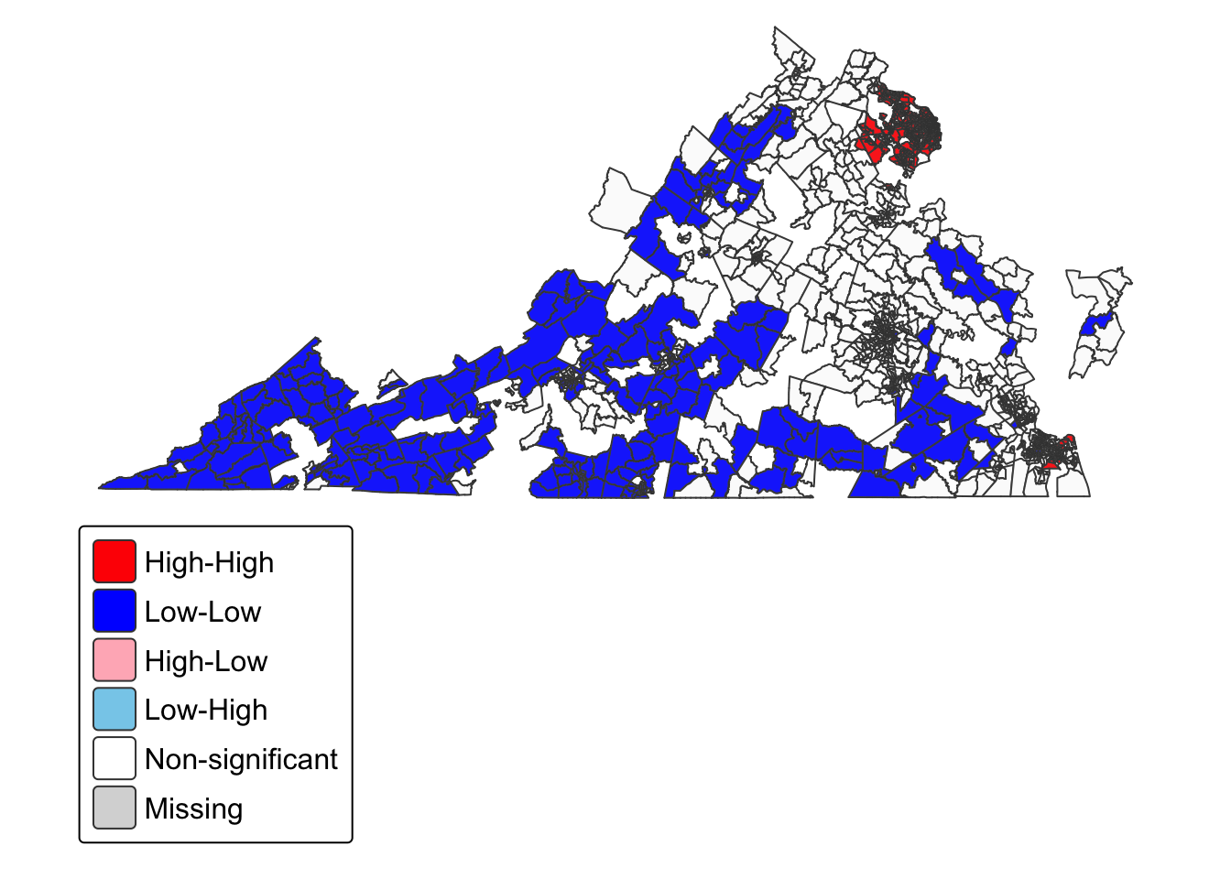
Rent Map, 2011 & 2016
Same as before, 2011 on the left and 2016 on the right.

Slide 13
Bivariate Moran’s I
Global and Local moran’s I statistic for two variables
Variable 1 (income) in once census tract -> Variable 2 (rent) in neighboring values
Ignores in-situ correlation between two variables
Only one variable can be displayed

Slide 14

Bivariate Moran’s I
Under 0.7 for most of the observation period
Horizontal trend once again

Slide 15
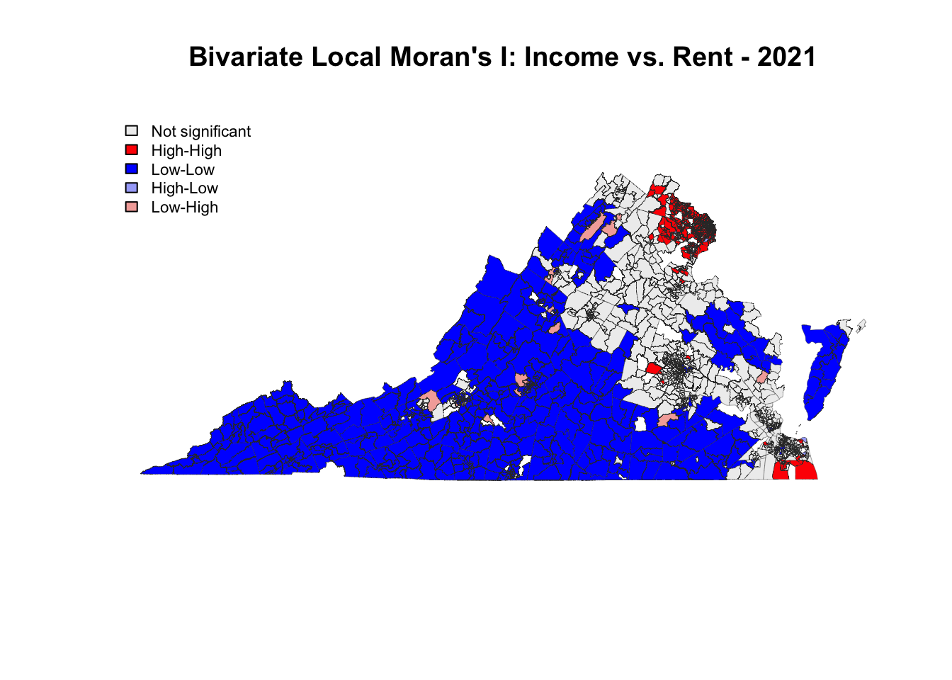
Bivariate Map, 2021
Low income and rent to the Southwest
High income and rent in suburbs
Many low rent and high income trends near smaller cities

Slide 16
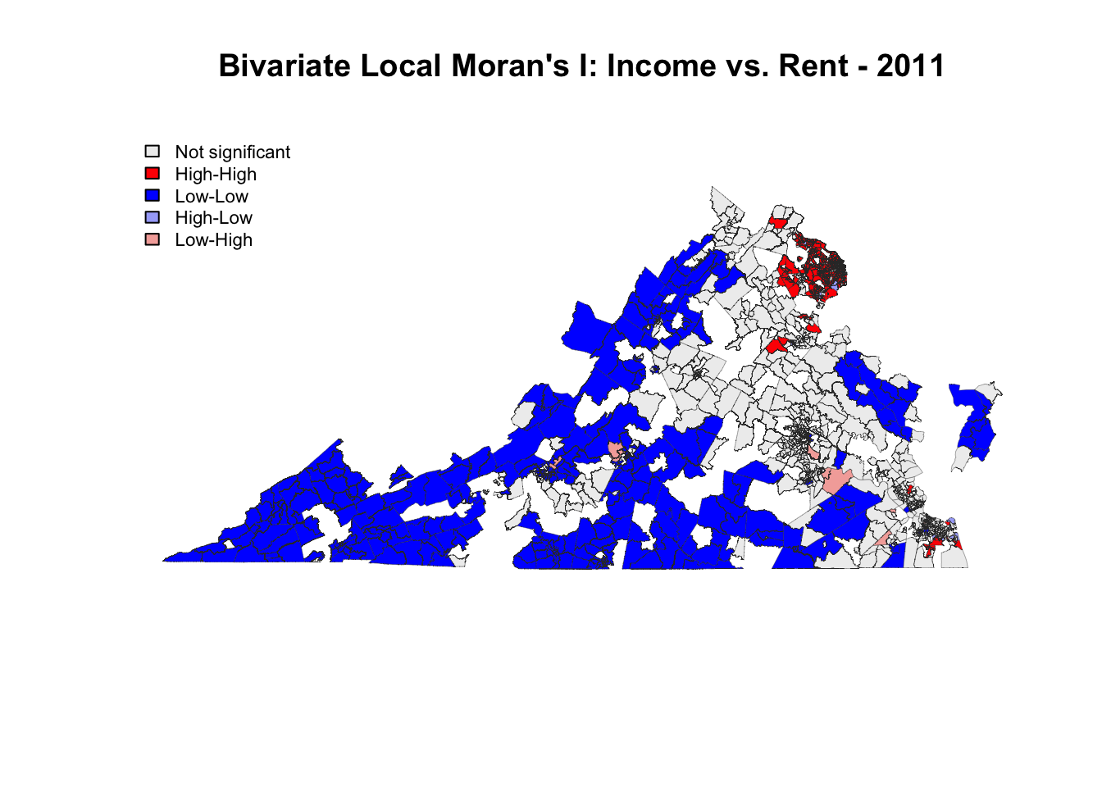
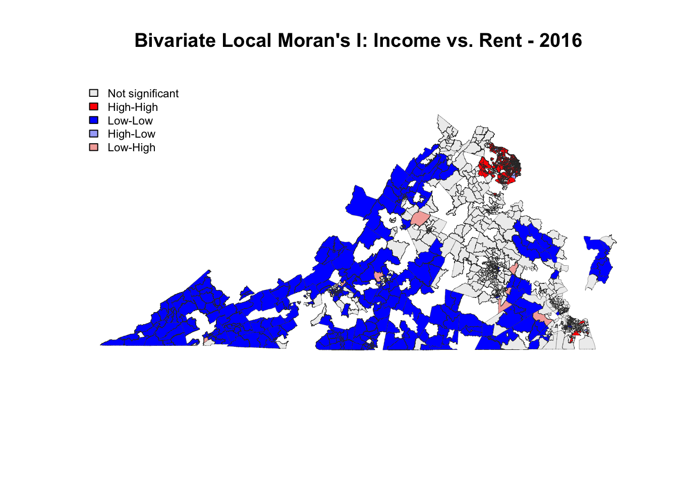
Bivariate Map, 2011 & 2016
2011 on the left and 2016 on the right, not rich in data once again

Slide 17
Summary
Cluster analysis of median household income and median gross rent in Virginia
Significance for Global and Local Moran’s I values was set at 0.05
With every Global Moran’s I at about 0.7, Virginia is very autocorrelated

Slide 18
Summary
High income and rent census tracts aggregated into clusters, as did low valued census tracts
High valued clusters exist in suburban areas, especially Northern Virginia (Fairfax is there)
Low valued clusters exist predominately in rural markets, especially Southwestern VA (within small areas in the cities as well)

Slide 19
Takeaways
Regional disparity is very prominent in Virginia
Wealth and rent affordability vary significantly by region: Northeastern is especially wealthier, Southwestern is poorer
In rural and small market areas, more land had low rent values and less low income values, indicating that renting is not particularly a luxury in those demographics. The opposite case was true for high rent values

